Slide 1

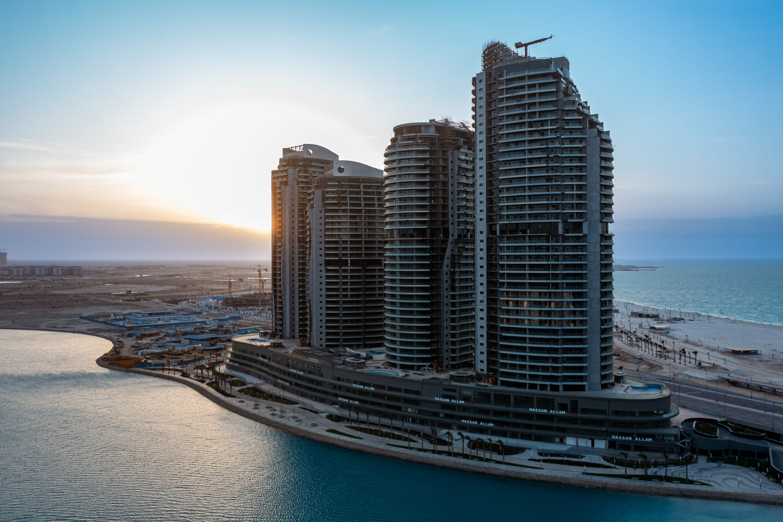
Cellula’s hotel
CELLULA’S
HOTEL
Presented by: Mohamed Naguib,Hassan Gebrill

Slide 2
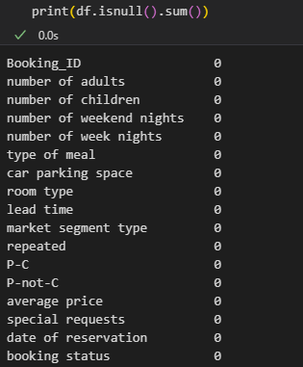
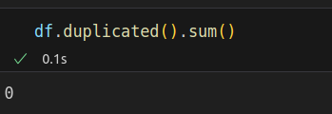
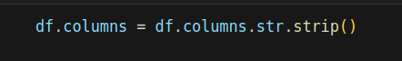
DATA PREPROCESSING
We checked if the data has NULL/Empty/Duplicate values to be cleaned

Slide 3
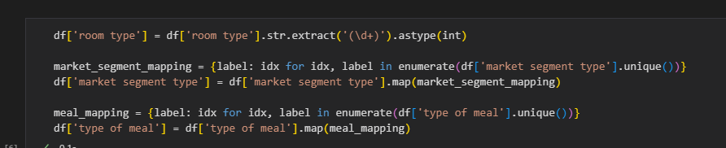
ENCODING
Changing data type from string to integer in order to be able to use the data.

Slide 4
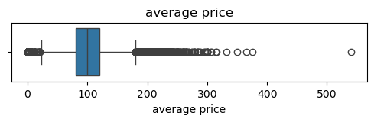
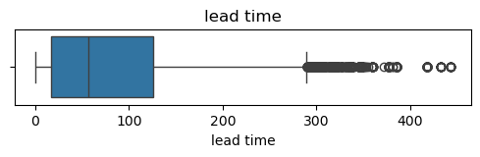
OUTLIERS
Outliers are the abnormalities in the data that needs to be removed
*These two were made with IQR

Slide 5
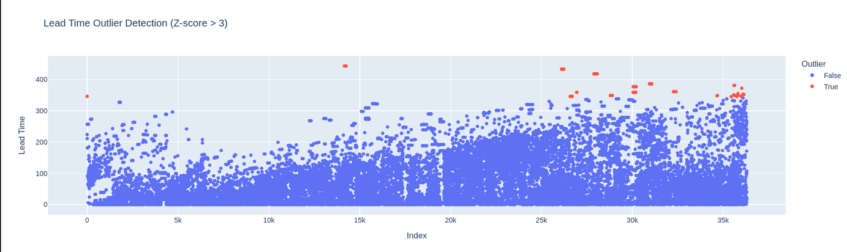
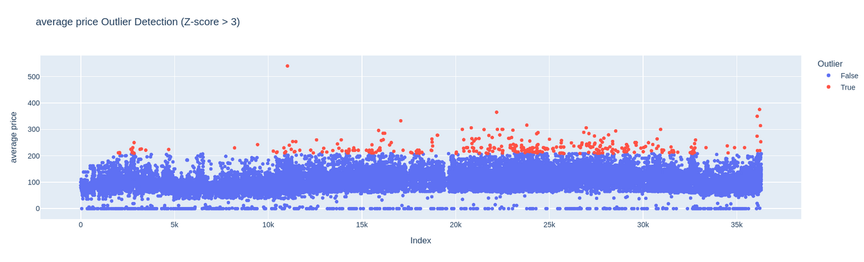
Z-Score
1% of data is
outlier in lead time
0.9% of data is
outlier in average price

Slide 6
FEATURE ENGINEERING
APPROACH 1
APPROACH 2
check Skewing of data
using log transformation
+ robust scaler to handle
outlier
Using smote to resample data and feature extraction
Data Normalization
Generated heatmap to figure important features

Slide 7

APPROACH 1
After cleaning the data and checking if there’s any missing values/NULL/Duplicate,We started visualizing the data then selecting features using logic and statistics,then we compared models in order to determine which model is best

Slide 8

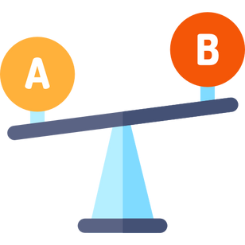
MODEL COMPARISON
Testing multiple models in order to determine which model to use
LOGISTIC REGRESSION -> 0.82
KNN -> 0.87
DECISION TREE -> 0.86
XGBoost -> 0.90

Slide 9

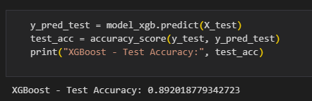
Testing the model
after choosing XGBoost due to its supremacy
we start testing the model for accuracy
XGBoost scored 0.89.

Slide 10
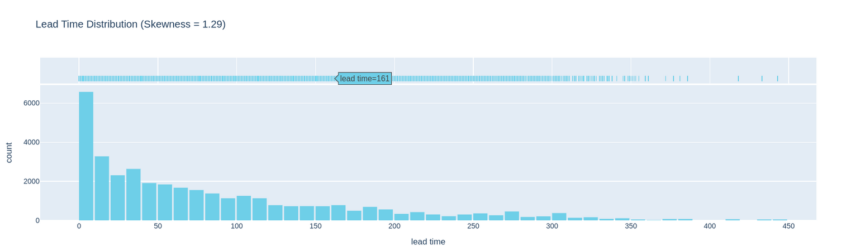
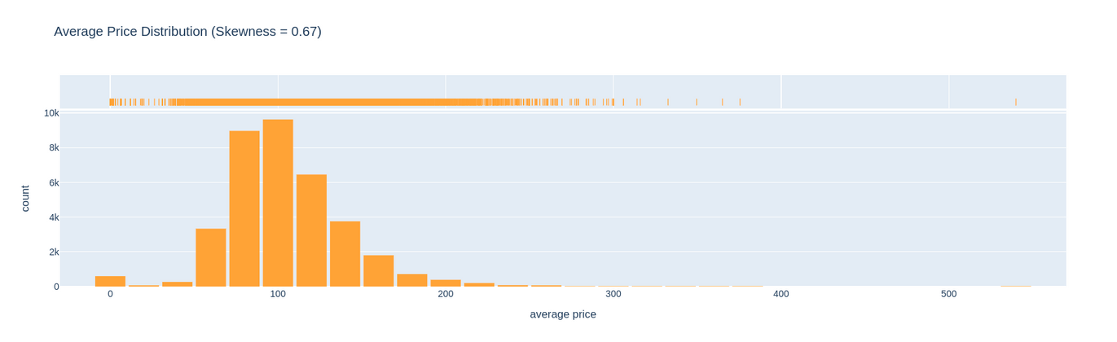
Approach 2
Skewness
Skewness ≈ 1.29 → Highly right-skewed
Skewness ≈ 0.67 → Moderately right-skewed

Slide 11
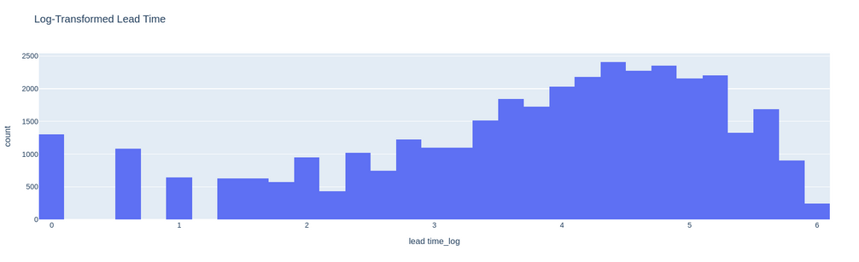
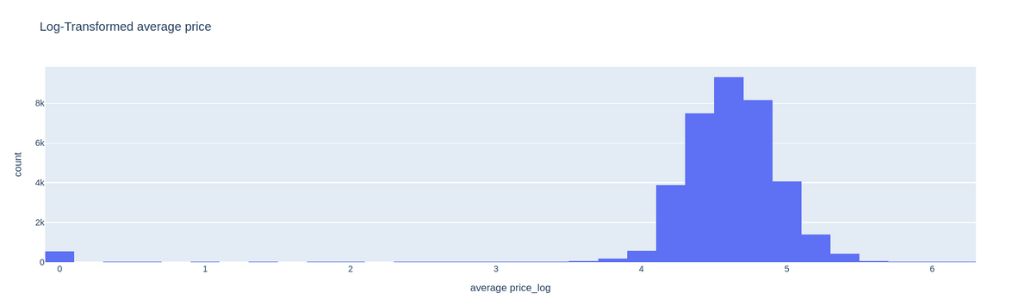
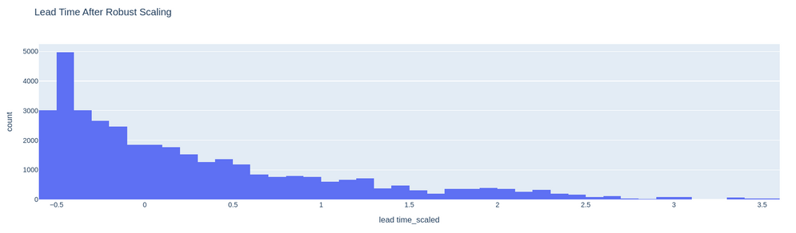
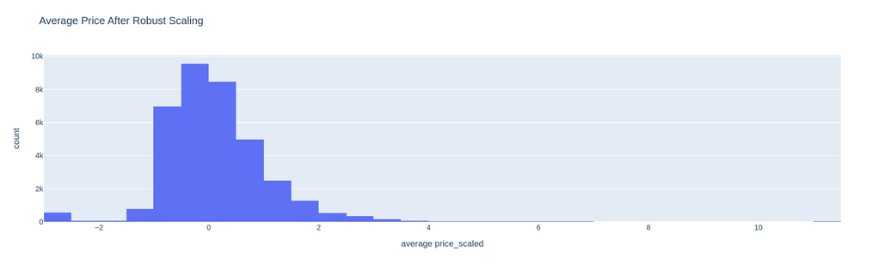
Log Transformation
Robust Scaler

Slide 12
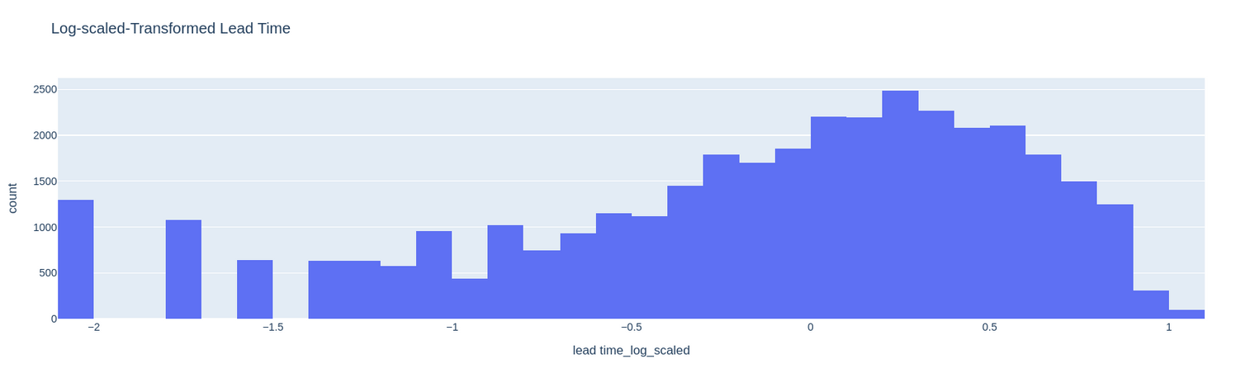
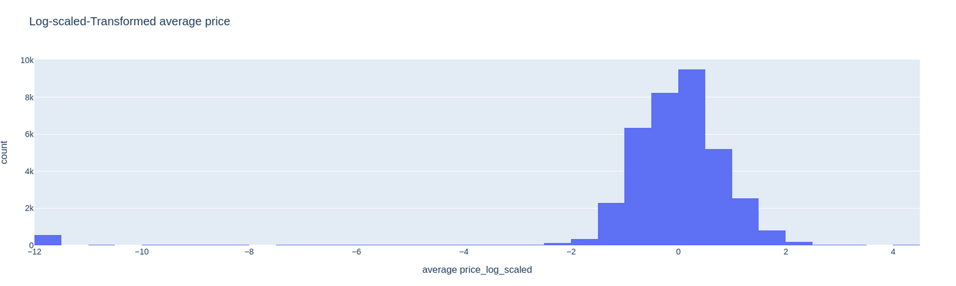
Using Log +Robust

Slide 13
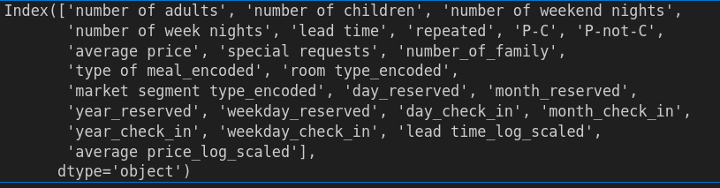
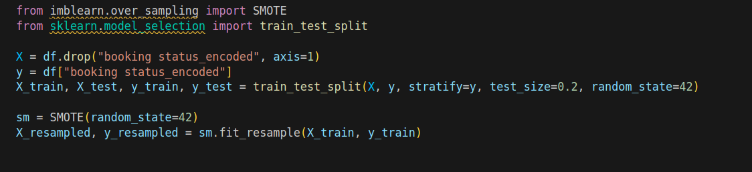
SMOTE and Feature extraction
Features :
Resampling :

Slide 14
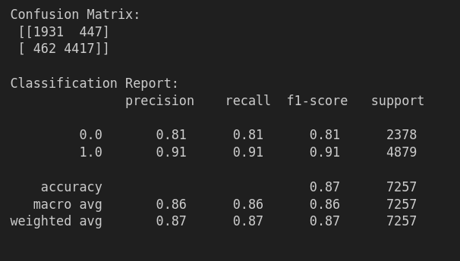
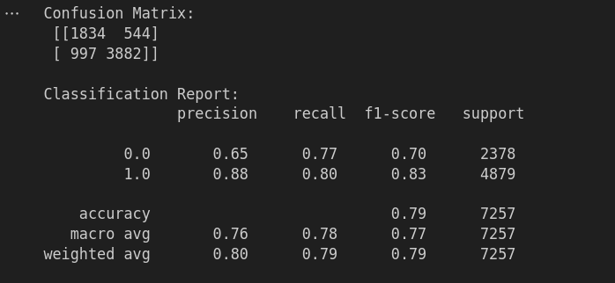
Modeling and accuracy
XG boost
Logistic Regression

